Slide 1

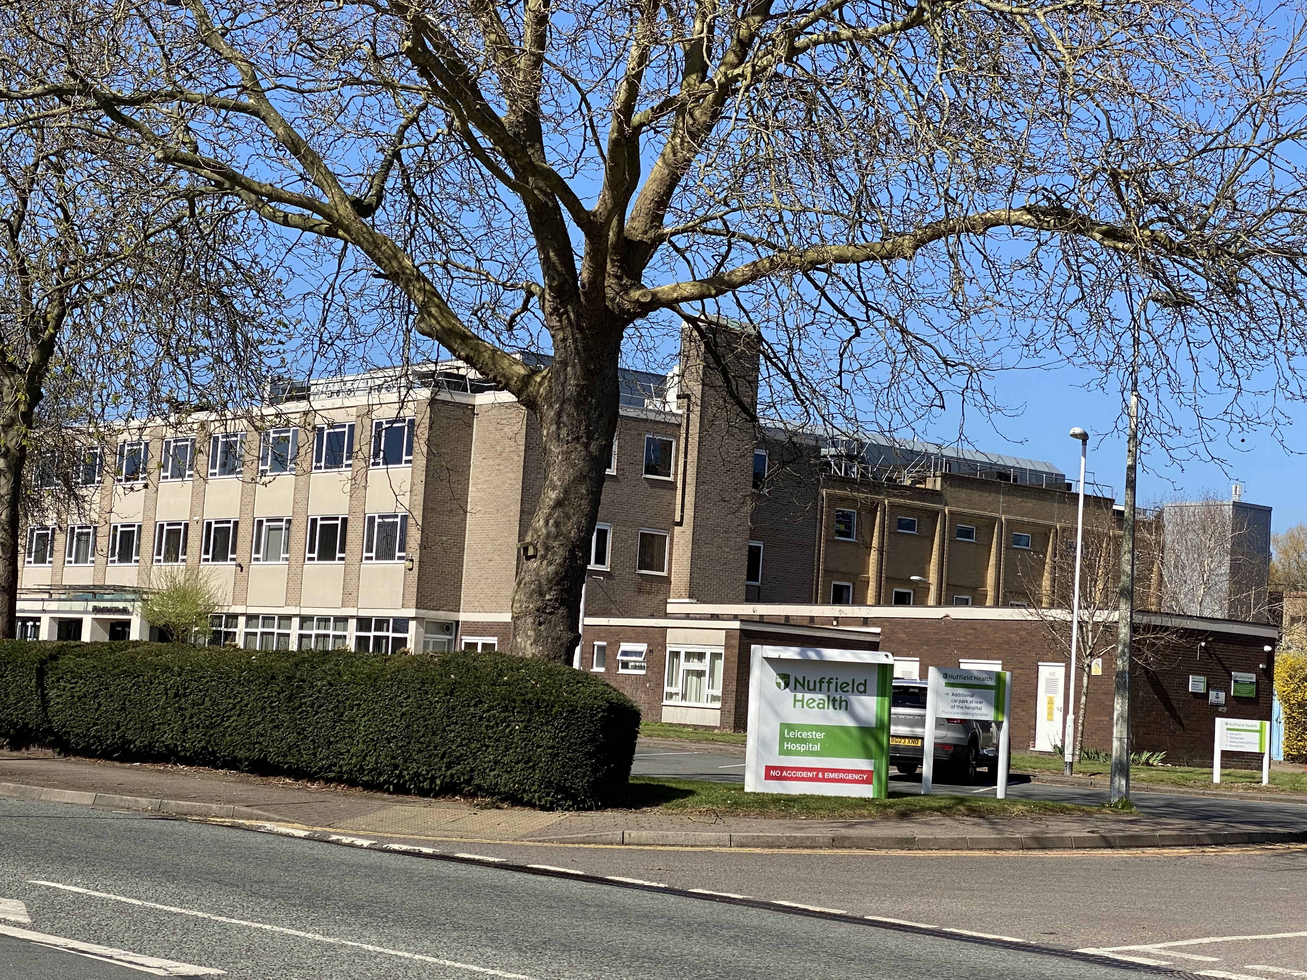

LeicesterShire medIco-legal society
Date: Thursday 19th June 2025
Time: Meet at 6pm for drinks and nibbles - 6.30pm start
Location:Nuffield Hospital, Scraptoft Lane, Leicester LE5 1HY
Parking:
Free parking available
Speaker: Dr Samrat Sengupta, Psychiatrist and Barrister
2 DRJ Chambers
Topic: Mental Health Homicides and Inquests
For any queries, please contact Christl Hughes lmedicoleg6@aol.com

